Slide 1
Porting Bluespec based IPs
SHAKTI Group | CSE Dept | PS-CDISHA - RISE LAB
IIT Madras

Slide 2
Agenda
1. | Introduction
2. | Existing peripherals & Adding New peripherals to SOC
3. | Classification of peripherals in Ganga & Yamuna SOC
4. | Flow of adding new peripheral into current project SOC
5. | Adding new (UART) peripheral into current project SOC
shakti.org.in

Slide 3
Introduction
Flow of adding new or removing existing peripherals from <TARGET SOC>, based on end application needs for a better utilization of LUT’s
Example (Adding UART peripheral) procedure can be followed for the other peripherals to add or remove
All the changes should done according to the below mentioned path
  cd gc2025/hw/boards/ “ < arty_a7_ganga> or <arty_a7_yamuna> ”

Slide 4
Existing Peripherals in both Ganga & Yamuna SOC
Ganga SOC
Yamuna SOC
256 MB of DDR and 8 KB of Boot ROM
16 GPIOs
2 x GPTs
2 x SPIs
2 x UARTs
1 x I2C
1 x PLIC
1 x CLINT
Onboard FTDI based Debugger
Ethernet Lite IP from Xilinx
256 MB of DDR and 8 KB of Boot ROM
32 x GPIOs
6 x PWMs
4 x GPTs
2 x SPIs
3 x UARTs
2 x I2Cs
1 x PLIC
1 x CLINT
1 x On board XADC
Onboard FTDI based Debugger
Ethernet Lite IP from Xilinx

Slide 5
Reconfigurable Peripherals in both Ganga & Yamuna SOC
In the both SOC’s all the peripherals can be configured based on end application.
Either these peripherals can be added or removed with the existing peripherals to the SOC.
  GPIO
  GPT
  UART
  I2C
  PINMUX
  SPI
  PWM
  PLIC

Slide 6
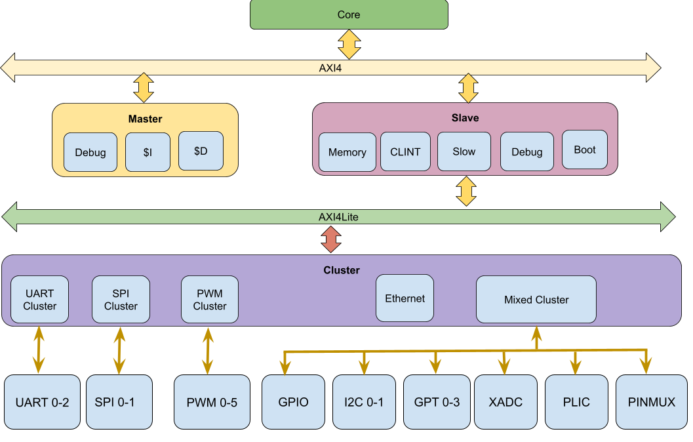
Classification of peripherals in Yamuna SOC

Slide 7
Flow of adding new peripheral into current project SOC
soc.defines
<target>_cluster.bsv
Soc.bsv
Incrementing PLIC signals
fpga_top.v
constraints.xdc

Slide 8




Adding new UART peripheral into current project SOC
Soc.defines
Add Cluster Base and End address for the UART.
2. Increment UART Cluster Slave Number

Slide 9

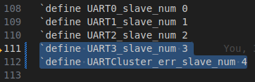
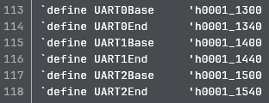
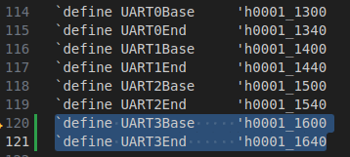
Adding new UART peripheral into current project SOC
3. Defining new UART3_slave_num as shown in below
4. Defining new UART3 Base address and End address

Slide 10
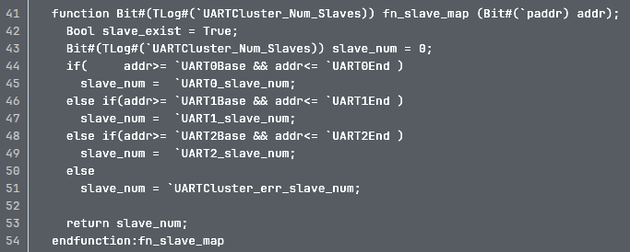
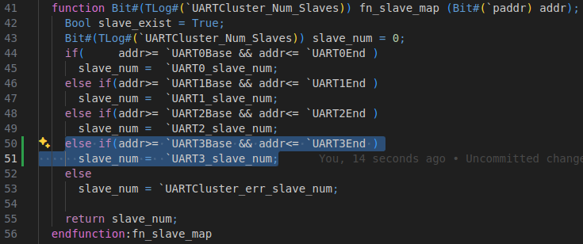
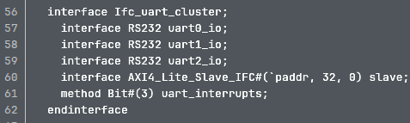
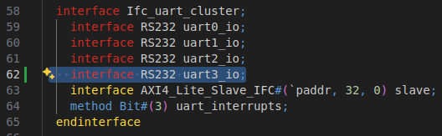
Adding new UART peripheral into current project SOC
uart_cluster.bsv
Adding new UART3 Base and End address for decoding logic in uart_cluster.bsv
2. Declaring new RS232 uart3_io interface

Slide 11




Adding new UART peripheral into current project SOC
3. Instantiating another new uart3 inside “mkuart_cluster” module
4. Declaring the interface RS232 of uart3_io with uart3.io inside “mkuart_cluster” module

Slide 12


Adding new UART peripheral into current project SOC
5. Connecting new UART3 from AXI4_lite slave to AXI4_lite Master using mkconnection inside “mkuart_cluster” module

Slide 13
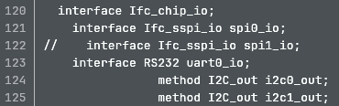
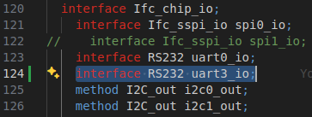


Adding new UART peripheral into current project SOC
Soc.bsv
Declaring new “interface uart3_io RS232” inside “Ifc_chip_io” interface to take the new uart3 signals to out (on board)
2. Declaring the uart3_io interface instance which is declared in “mkuart_cluster” module to connect the new UART3 peripheral from uart_cluster.bsv to “Soc.bsv”

Slide 14
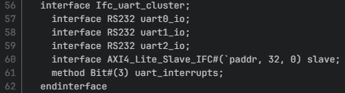

Adding new UART peripheral into current project SOC
uart_cluster.bsv
Incrementing uart_interrupt signals after adding a new UART3 peripheral, in method declaration, to pass new peripheral to PLIC

Slide 15
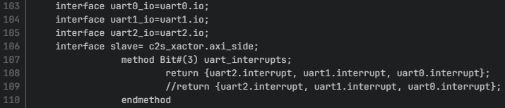
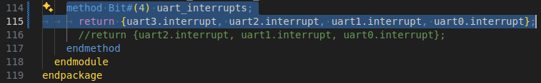
Adding new UART peripheral into current project SOC
uart_cluster.bsv
2. Incrementing uart_interrupt signals in method declaration, inside mkuart_cluster declaration, to pass new peripheral to PLIC

Slide 16
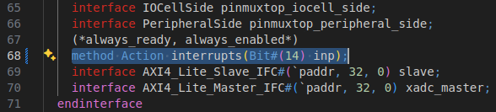
Adding new UART peripheral into current project SOC
mixed_cluster.bsv
1. Incrementing interrupt signals in “Ifc_mixed_cluster” interface declaration, in mixed_cluster.bsv to pass new peripheral to PLIC (UART is declared as external interrupt)

Slide 17
Adding new UART peripheral into current project SOC
mixed_cluster.bsv
2. Incrementing external_interrupt signals in “mkmixed_cluster” module, inside mixed_cluster.bsv to pass new peripheral to PLIC (UART is declared as external interrupt)

Slide 18


Adding new UART peripheral into current project SOC
mixed_cluster..bsv
3. Incrementing external_interrupt signals in method declaration, inside mixed_cluster.bsv to pass new peripheral to PLIC (UART is declared as external interrupt)

Slide 19
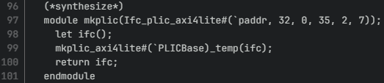
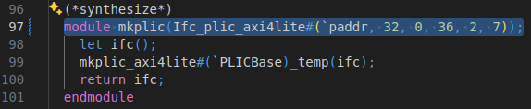
Adding new UART peripheral into current project SOC
mixed_cluster.bsv
4. Incrementing PLIC signals in mkplic module, inside mixed_cluster.bsv to pass new peripheral to PLIC (UART is declared as external interrupt)

Slide 20
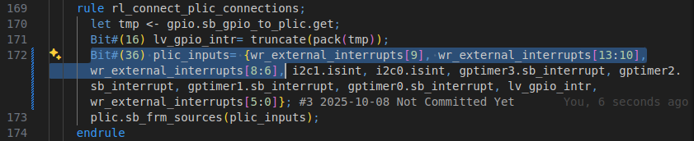
Adding new UART peripheral into current project SOC
mixed_cluster.bsv
5. Incrementing PLIC signals in rule declaration of rl_connect_plic_connections, inside mixed_cluster.bsv to pass new peripheral to PLIC (UART is declared as external interrupt)

Slide 21
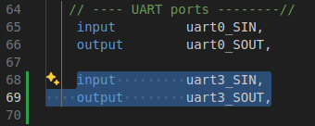

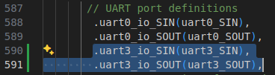

Adding new UART peripheral into current project SOC
fpga_top.v
Declaring new “uart3_SIN & uart3_SOUT” IO ports in fpga_top.v to take the signals out onto the board
2. Connecting the declared new uart3 ports to the UART module in SHAKTI <TARGET>SOC

Slide 22
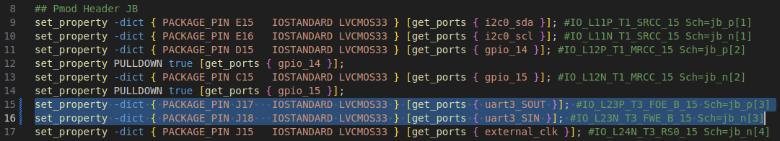
Adding new UART peripheral into current project SOC
constraints.xdc
Mapping new “uart3_SIN & uart3_SOUT” IO ports in constraints.xdc in the available ports, if there is no available ports then find the original constraints for Arty A7 100t and connect the new uart3 ports.

Slide 23
TCL-based Bitstream & MCS Generation
For Ganga SoC
    make build BOARD=arty_a7_ganga
For Yamuna SoC
    make build BOARD=arty_a7_yamuna XLEN_build=32

Slide 24
Queries ?

Slide 25
Thank You !

Slide 26
Flow of adding new peripheral into current project SOC
Soc.defines
<target>_cluster.bsv
Soc.bsv
fpga_top.v
constraints.xdc

Slide 27
Classification of peripherals in Ganga & Yamuna SOC
SOC
Fast Peripheral
Slow Peripheral
SPI
GPIO
PWM
GPT
XADC
I2C
ETHERNET
PLIC
AES
UART
SHA
PINMUX

